Slide 1
INTERVEHICULAR NETWORKING
Guided by:
Ms. Sandhya P
Asst. Professor
Presented by:
Arjun S-20
Ananthakrishnan R– 14
Rahul S – 43
Viswanth V S-58

Slide 2
INTRODUCTION
Nowadays, vehicles on the road are increasing at a rapid rate, Thus are the chances for increasing road accidents.
Majority of the accidents are due to lack of human intervention while driving.
Thus we came to propose an idea of Inter-vehicular networking.
It comprises of various systems including overtaking possibility detection, accident location tracking, automatic braking system, noiseless horn which are IoT based.

Slide 3
PROBLEM STATEMENT
Due to the increase in population, the automobile demand also increases. Thus, the causes of accidents are booming day after day.
The main cause of such problems are reckless overtaking measures, speeding and poor traffic management.
Therefore, providing convenient safety measures to vehicles by incorporating inter-vehicular networking by imposing new requirements for application and services such as, safety messaging, proper and safer overtaking in highways and effective traffic monitoring.

Slide 4
OBJECTIVE
Vehicular networking imposes new requirements for application and services such as, safety messaging, traffic monitoring, better consciousness of road artefacts.
The system provides service requirements in terms of latency, throughput and reliability on the network.

Slide 5
MOTIVATION
The main motivation is to decrease the on-road accidents and to make the driver to have a better conciseness of road artefacts.
This interlinking of advanced technologies among the car helps in producing a better standard of living.
To produce a better and easy interface between the driver and the vehicle.
To decrease the blind spot weakness of the vehicles.
To have an instantaneous alertness when the accident occurs .
To minimise the excessive noise pollution caused by the vehicle.

Slide 6
WORKING METHODOLOGY
The ultra sonic sensors placed at the front and the back end of the system is responsible for obstacle detection and is displayed in the LCD panel.
The sensor at the front detects the opposing vehicle and shows the overtaking chances . While taking the reverse direction ,the sensor at the back detects obstacle and if it is within the specified threshold value, the vehicle stops automatically.
TSOP transmitter and receiver is also set upped on the vehicle to execute noiseless horn indication.
The vehicle is controlled via Bluetooth and performs forward ,backward ,left and right motions.
A suitable power supply is needed which is of 12V is given via an external power source.

Slide 7
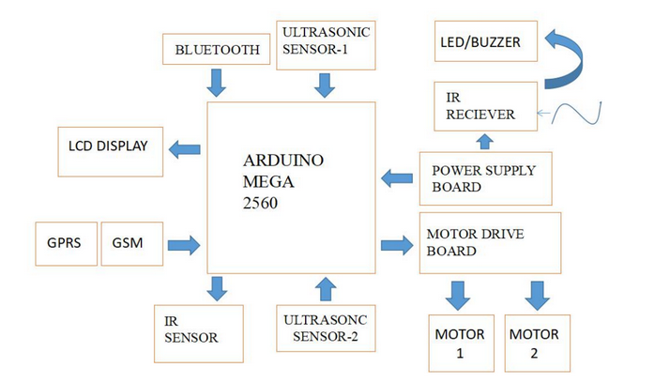
BLOCK DIAGRAM

Slide 8
LITERATURE REVIEW
ANALYSIS OF INFORMATION DISSEMINATION IN VEHICULAR AD-HOC NETWORKS WITH APPLICATION TO COOPERATIVE VEHICLE SAFETY SYSTEMS
The above quoted paper showcases vehicular collision avoidance support system(vcass), and demonstration is done by various experimentation with the help of two actual vehicles. personal computers, telecommunication equipments, and GPS has been installed inside these vehicles to exchange multiple information and theory ceasing a link. the vehicle could then exchange the location data as well as its rate of change of position with the other vehicles with the help of a UDP (user diagram protocol)broadcast and thereby calculates the concerned relative position.

Slide 9
LITERATURE REVIEW
DEVELOPMENT OF VEHICULAR-COLLISION AVOIDANCE SUPPORT SYSTEM BY INTER-VEHICLE COMMUNICATIONS.
The above paper illustrates Cooperative vehicle safety systems (CVSSs) which rely on vehicular ad-hoc networks (VANETs) for the delivery of captious vehicle tracking contents. It uses wireless channels such as WLAN (Wi-Fi/Zigbee) which connects vehicles to a wireless router or nodes and thereby both are within the transmission range to exchange any possible collision warnings. But its main disadvantage is that it struggles to obtain accuracy since vehicle density is changing rapidly at a given time as well as any possible network issue can make the system to fail miserably as it solely depends upon inter-connectivity.

Slide 10
LITERATURE REVIEW
OVERTAKING ASSISTANT SYSTEM (OAS) WITH FUZZY LOGIC METHOD USING CAMERA SENSOR
This above paper outlines about Overtaking assistant system (OAS) which is one of the Advanced driver-assistance subsystem which is capable of assisting the driver while overtaking and thereby contributes in its decision making. From this experiment, an OAS is used for overtaking one vehicle on roads whether it is one way or two way. It has been realized with the help of radio control (RC) car. Fuzzy logic is a logic method which uses truth values by considering any real number between 0 and 1(both are included) is employed to handle the idea of partial truth which is used as the overtaking decision-making method. RC car’s pixel width is converted into distance between the other car is done with the help of Pixy CMUcam5.Suitable delay will be shown if overtaking is not safe while calculating the fuzzy logic rule.

Slide 11
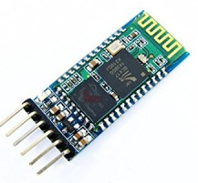
COMPONENTS
BLUETOOTH MODULE :
A Bluetooth module is usually a hardware component that provides. a wireless product to work with the computer; or in some cases, the Bluetooth may be an accessory or peripheral, or a wireless headphone.

Slide 12
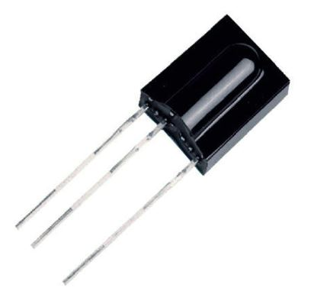
COMPONENTS
TSOP SENSOR :
The TSOP 1738 is a member of IR remote control receiver series.
This IR sensor module consists of a PIN diode and a pre amplifier which are embedded into a single package.
The output of TSOP is active low and it gives 5V in off state.

Slide 13
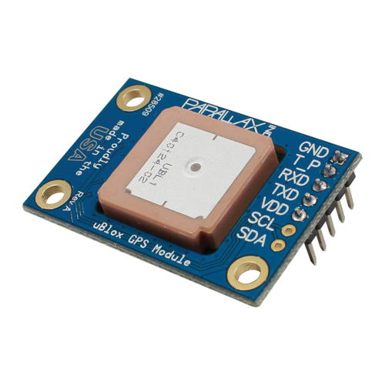
COMPONENTS
GPS MODULE
The Global Positioning System (GPS) is a device that is capable of receiving information from GPS satellites and then to calculate the device's geographical position. Using suitable software, the device may display the position on a map

Slide 14
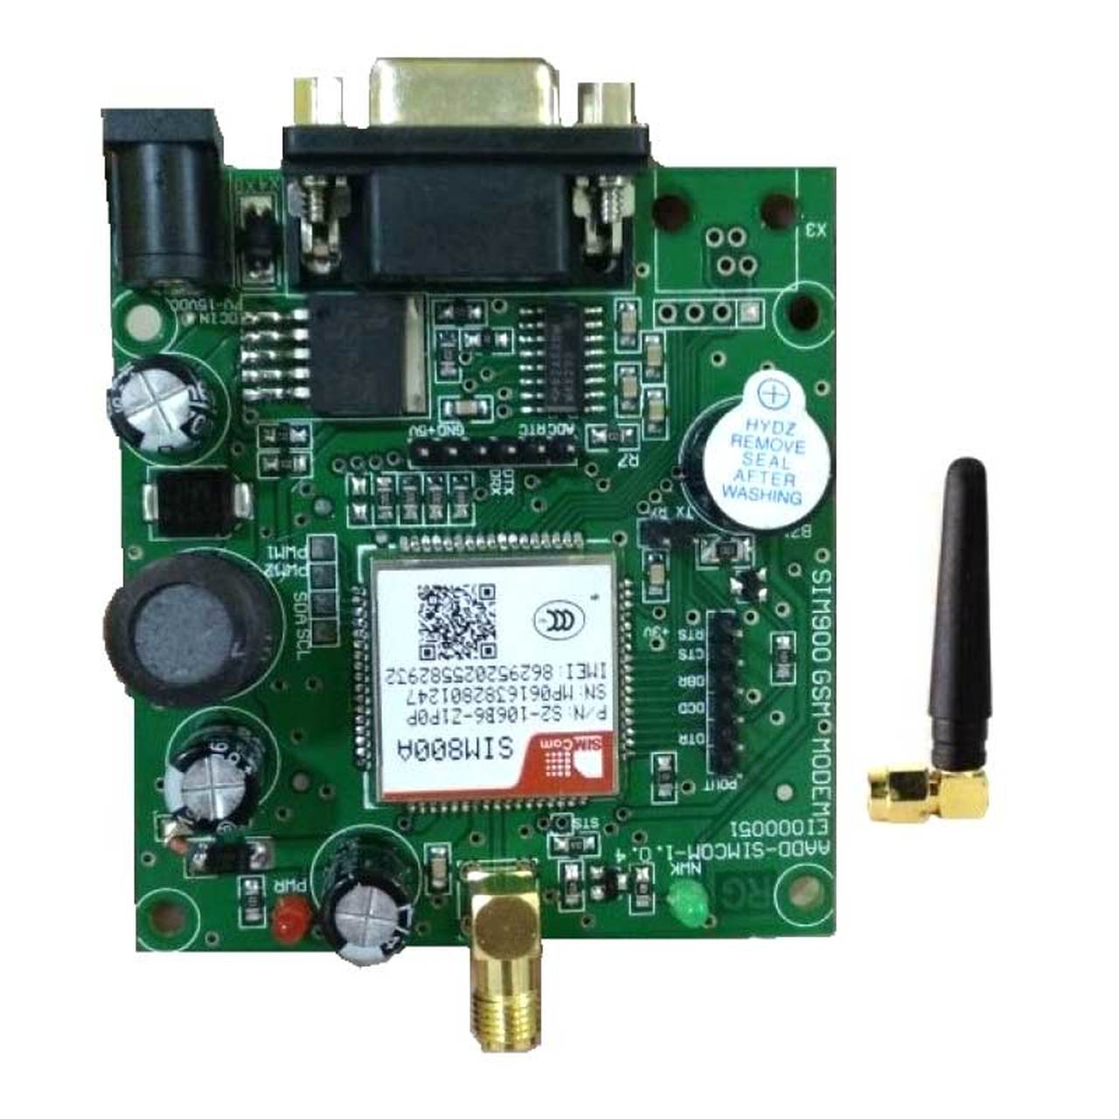
COMPONENTS
GSM MODULE:
A Global System for Mobile Communications (GSM) module is a chip or circuit that will be used to establish communication between a mobile device or a computing machine and a GSM.

Slide 15
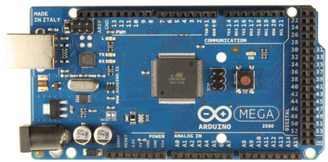
COMPONENTS
ARDUINO MEGA :
The Arduino Mega 2560 is a microcontroller board based on the ATmega2560 (datasheet).
It has 54 digital input/output pins (of which 14 can be used as PWM outputs), 16 analog inputs, 4 UARTs (hardware serial ports), a 16 MHz crystal oscillator, a USB connection, a power jack, an ICSP header, and a reset button.
It contains everything needed to support the microcontroller; simply connect it to a computer with a USB cable or power it with a AC-to-DC adapter or battery to get started.

Slide 16
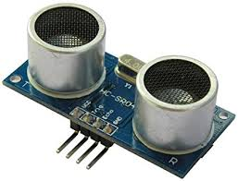
COMPONENTS
ULTRASONIC SENSOR:
Ultrasonic sensors measure distance by using ultrasonic waves.
The sensor head emits an ultrasonic wave and receives the wave reflected back from the target.
Ultrasonic Sensors measure the distance to the target by measuring the time between the emission and reception.

Slide 17
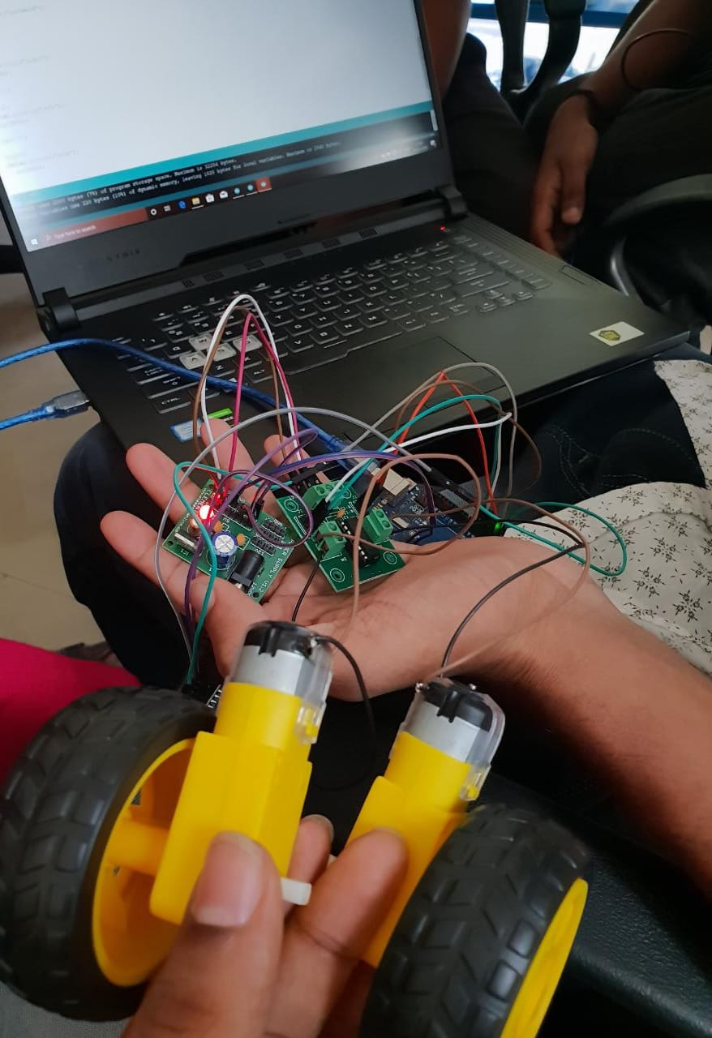
COMPONENTS
MOTORDRIVER BOARD
The IC used is LM293D . It consists of a 5V ,ground and a 12V pin.
It also consists of 2 sets of pins C1A,C1B,C2A&C2B which are used to control the movement of the wheel.

Slide 18
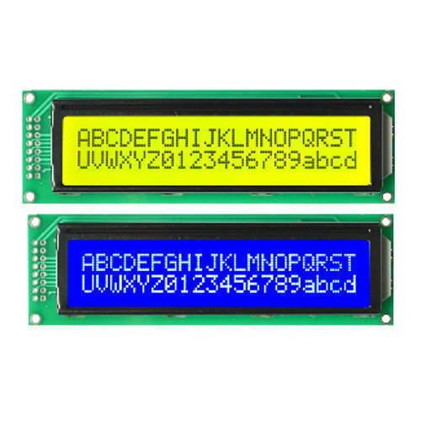
COMPONENTS
LCD DISPLAY
A Liquid crystal display is a flat panel display or other electronically modulated optical device that uses the light-modulating properties of liquid crystals.
Liquid crystals do not emit light directly, instead using a backlight or reflector to produce images in color or monochrome.

Slide 19
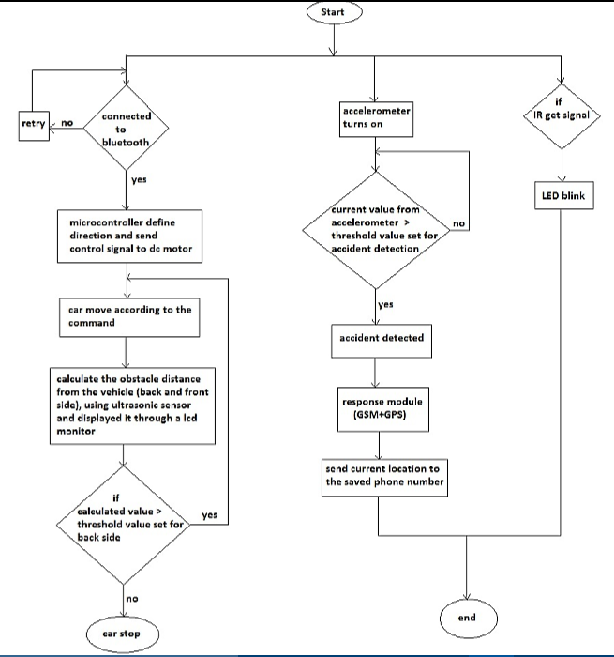
FLOWCHART

Slide 20
RESULT
The following results were obtained by integrating the different components from testing the system under given condition.
Signals from the tsop sensors gives an alert feature to the other vehicle such that noiseless horn working is acquired.
Motor driver board and the motor provides movement of the vehicle by controlling it through Bluetooth via smartphone.
Obstacles are detected while overtaking and close calls are displayed on the lcd panel.
The vehicle is automatically stopped while detecting the obstacles while in reverse motion avoiding collisions.

Slide 21
BUDGET
COMPONENTS | COST
TSOP SENSOR(2 nos.) | 500/-
ARDUINO MEGA | 1100/-
LCD DISPLAY | 150/-
ULTRASONIC SENSOR(2 nos.) | 250/-
BLUETOOTH MODULE | 220/-
MOTORDRIVER BOARD | 500/-
CAR CHASIS | 600/-
ARDUINO JUMPERWIRE KIT | 200/-
ARDUINO ADAPTER | 250/-
POWERBANK | 800/-
TOTAL | 4750/-

Slide 22
CHALLENGES FACED
The automatic reverse braking in the system worked, but after this the vehicle could not perform forward motion due to technical code errors.
Due to the covid scenario we were unable to integrate the location tracking onto our prototype thereby only able to complete 75% of the project.

Slide 23
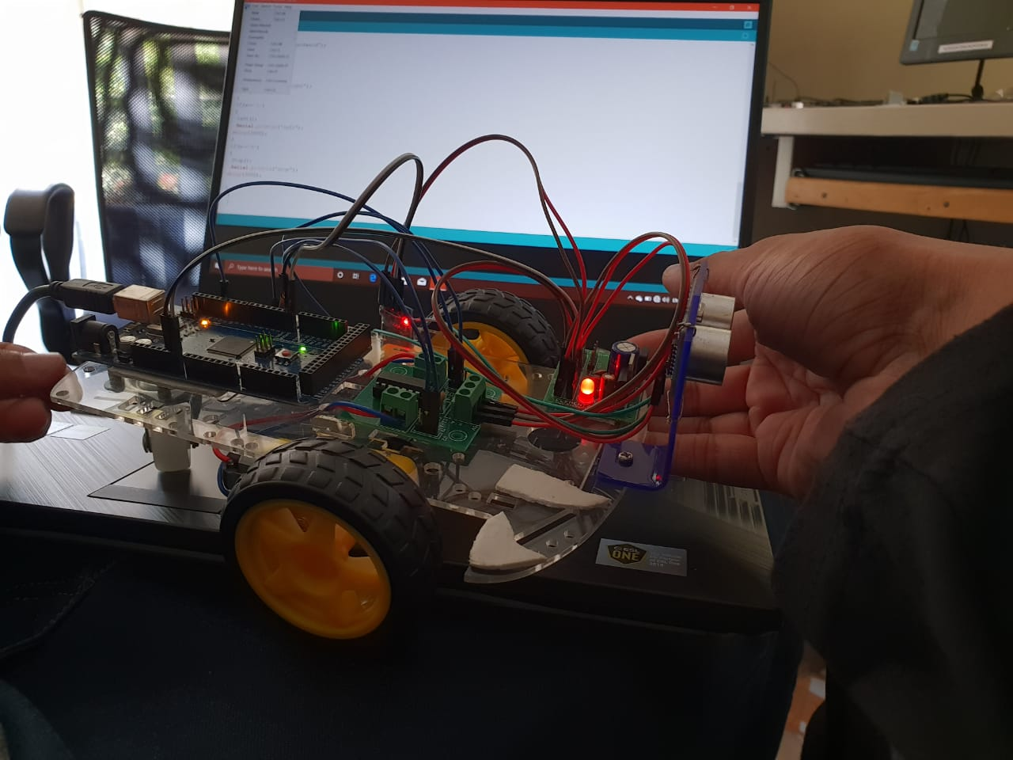
PROTOTYPE OF THE MODEL
Uploading the coding to the arduino unit and checking for updates

Slide 24
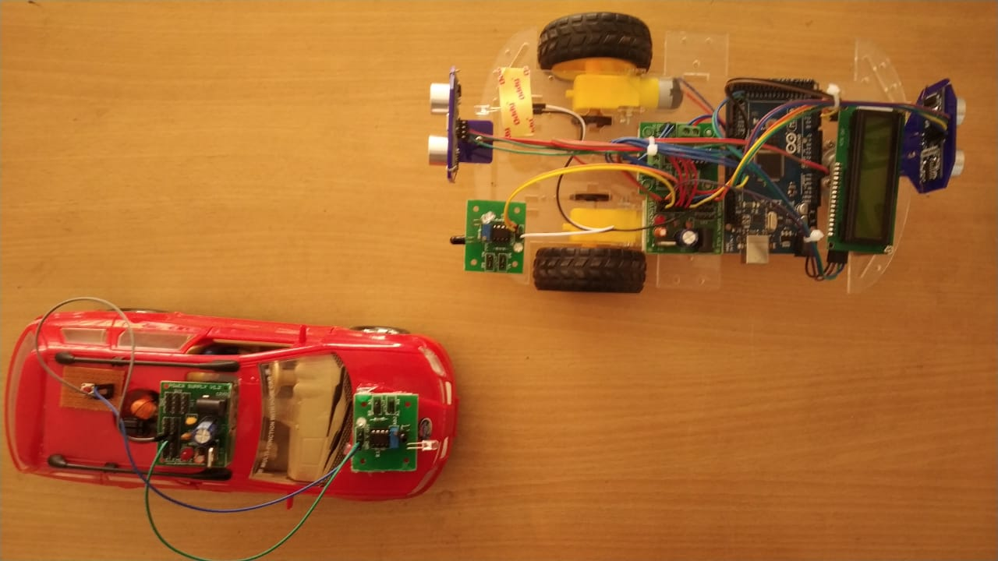
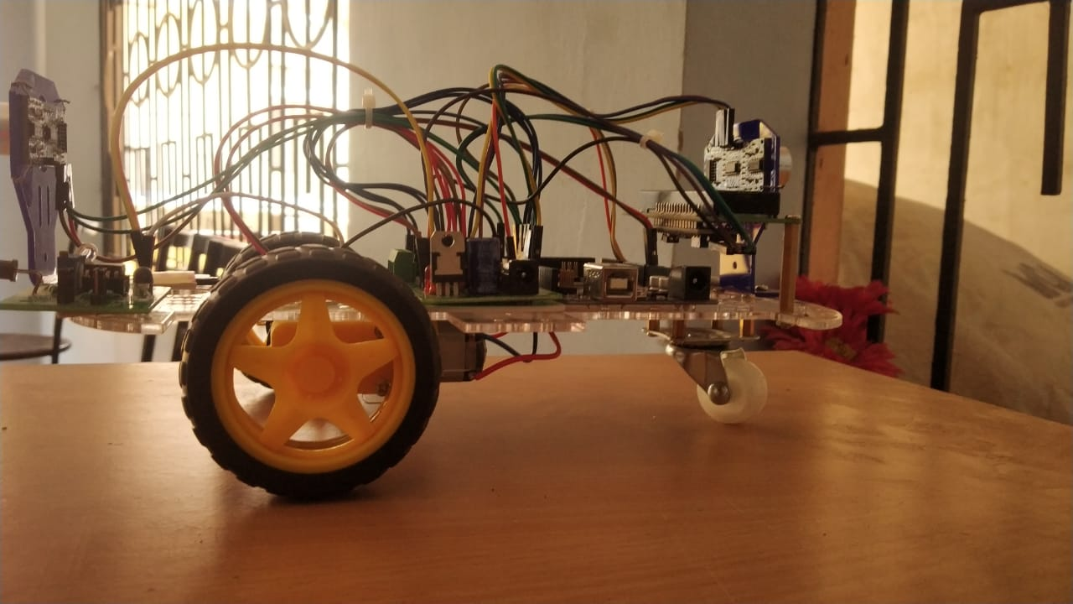
PROTOTYPE OF THE MODEL
These figure show the prototype after the completion of trials.(Current progress of the project)
The car chassis is implemented with LCD display , Motor driver board , Ultrasonic sensor ,Arduino

Slide 25

VIDEO PRESENTATION

Slide 26
CONCLUSION
The key design objectives in Communication vehicle networking(CVN) are to improve performance of the network in terms of transmission reliability, throughput, and interference by introducing cooperation among vehicles.
A vehicle-to-vehicle communication protocol for cooperative collision warning, overtaking chances and location sensing. Emerging wireless technologies for vehicle-to-vehicle (V2V) communications are promising to dramatically reduce the number of fatal roadway accidents by providing early warnings.

Slide 27
REFERENCE
Khalid Anindyaguna, Noor Cholis Basjaruddin, ‘’Overtaking assistant system (OAS) with fuzzy logic method using camera sensor’’, 2016 2nd International Conference of Industrial, Mechanical, Electrical and Chemical Engineering(ICIMECE).
Fallah YP, Huang CL, Sengupta R, Krishnan H. ‘’Analysis of information dissemination in vehicular ad-hoc networks with application to cooperative vehicle safety systems’’. IEEE Trans Veh Technol. 2011 Jan;60(1):233–247.

Slide 28


